Slide 2
Introduction

Slide 3
Introduction – SCM
Septic cardiomyopathy (SCM) is a cardiac dysfunction that develops in patients with sepsis;
Characterised by impaired cardiovascular performance;
Occurs when host response to an infection becomes dysregulated.
2

Slide 4
Introduction – SCM
Its diagnosis remains a challenge, making early detection difficult and mortality rates higher;
Estimated to affect 40-70% of adult patients with sepsis;
Some studies have associated SCM with increased mortality, while others have not found evidence.
3

Slide 5
Introduction – Objectives
Develop a method to accurately diagnose SCM based on patients’ personal and medical information;
Identify relevant patterns to support early and reliable diagnosis;
Dataset containing 207 attributes from 100 patients.
4

Slide 6
Methodology

Slide 7
Features of interest
Defining the target – “OBITO”;
Features with highest correlation with the target:
“Recov”;
“Dias_ate_morte”;
“RecovTime”.
6

Slide 8
Categorical features
“SEXO” – binarization;
“Agent” – embedding vectors.
7

Slide 9
Missing values
4% of dataset consisted of missing values.
Table 1 – Percentage of missing values for the features with the highest percentage
Feature | % of missing values
Vrenais_padrão≥0,8 | 43
Vrenais_padrão<0,7 | 43
Indice_resistencia | 43
Arenais_Vmin | 43
Arenais_Vmax | 43
CD4_CD8 | 37
PVC | 22
8

Slide 10
Missing values
Methods to fill missing values:
Mean;
Median;
Regression;
Multiple Imputation by Chained Equations (MICE):
MICE with regressions;
MICE with decision trees.
9

Slide 11
Missing values
Constant values for “Dias_ate_morte” and “RecovTime”;
Logarithmic transformation.
10

Slide 12
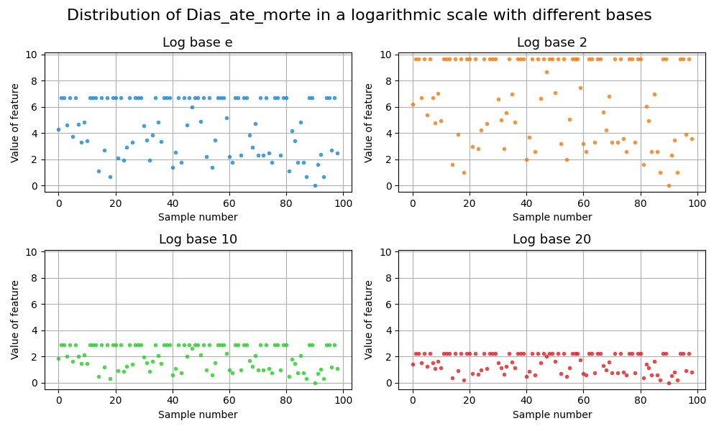
Missing values
Figure 1 – Distribution of Dias_ate_morte in a logarithmic scale with different bases
11

Slide 13
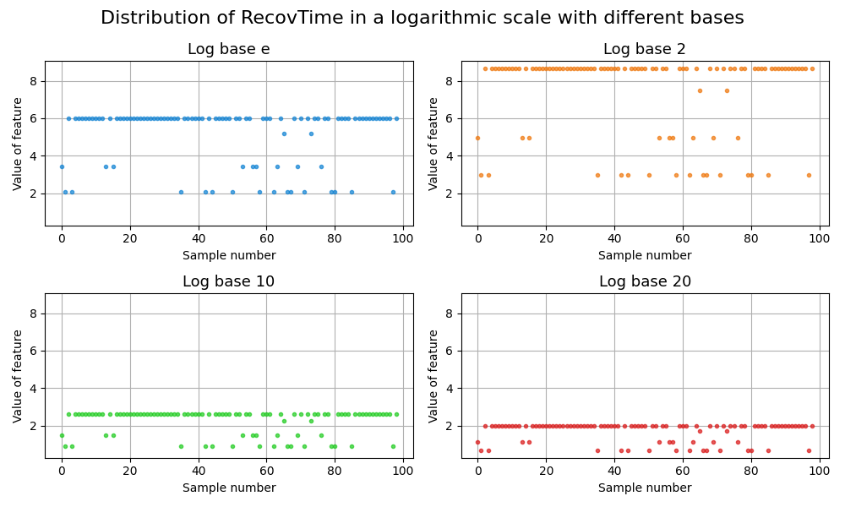
Missing values
Figure 2 – Distribution of RecovTime in a logarithmic scale with different bases
12

Slide 14
Feature selection
Correlation-based feature selection:
Correlation matrix;
Threshold = mean of correlations + k * standard deviation;
Tie-breaking criterion;
Principal Component Analysis (PCA):
20 principal components;
Cumulative Variance Explained (CEV).
13

Slide 15
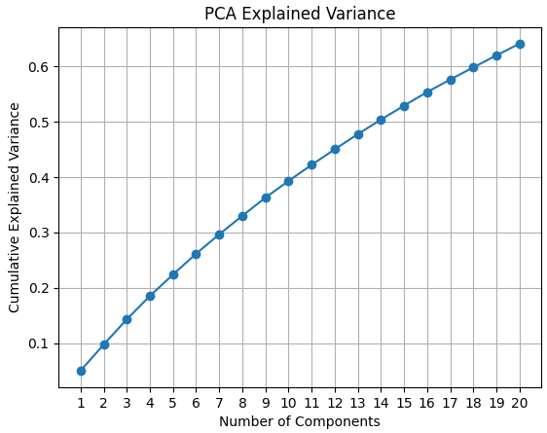
Feature selection
Figure 3 – Evolution of CEV over number of components selected
14

Slide 16
Final model
Splitting into training and validation (80%) and testing (20%) sets;
Fuzzy C-means clustering:
2 clusters;
Gaussian membership function.
15

Slide 17
Final model
Takagi-Sugeno (TSK):
Hybrid ANFIS training method:
Gradient descent for antecedent parameters;
Least squares for consequent parameters;
Leave-One-Out Cross-Validation:
Number of clusters (n=2);
Fuzziness parameter (m=2).
16

Slide 18
Results and discussion

Slide 19
Model performance – metrics
After hyperparameter tuning and training, the model was evaluated on the test set;
Final training phase restricted to small number of epochs.
Table 2 – Final performance metrics obtained
Accuracy | F1 Score | Recall | Precision
0.6500 | 0.6316 | 0.6667 | 0.6000
18

Slide 20
Model performance – Confusion matrix
Confusion matrix plotted for the test set;
In medical contexts, false negatives represent cases in which a patient is incorrectly classified as healthy.
19

Slide 21
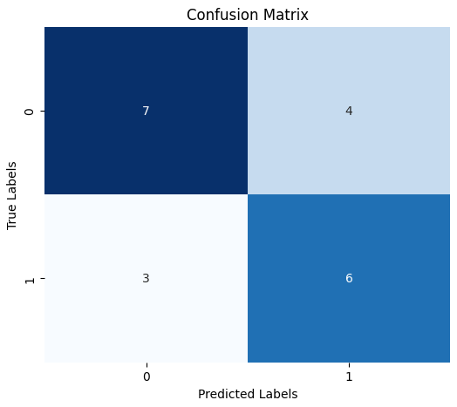
Model performance – Confusion matrix
Figure 4 – Confusion Matrix
20

Slide 22
Results interpretation
Results obtained were suboptimal, with model accuracy equal to 65%;
False negatives were least frequent error type;
Outputs of TSK model plotted with different colours to distinguish between correctly or incorrectly classified.
21

Slide 23
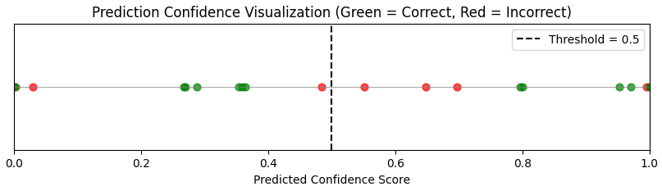
Results interpretation
Figure 5 – Prediction confidence scores
22

Slide 24
Results interpretation
Real-world medical dataset characterised by complex, highly independent variables and relatively low variance among samples;
Difficulty of identification of boundaries between classes reflected in low clustering performance (clustering score of 0.3333).
23

Slide 25
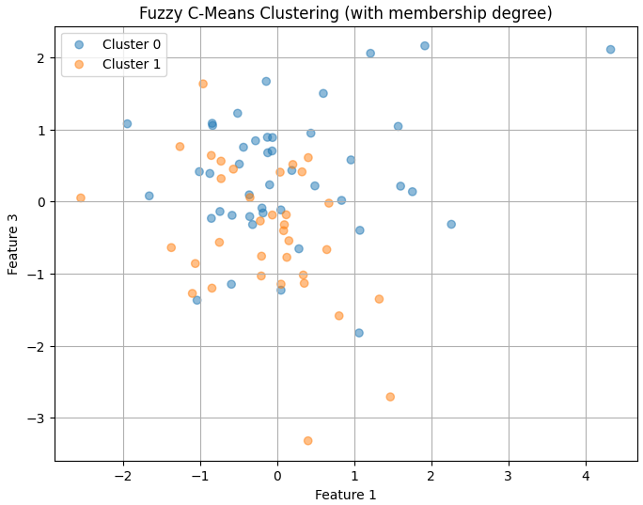
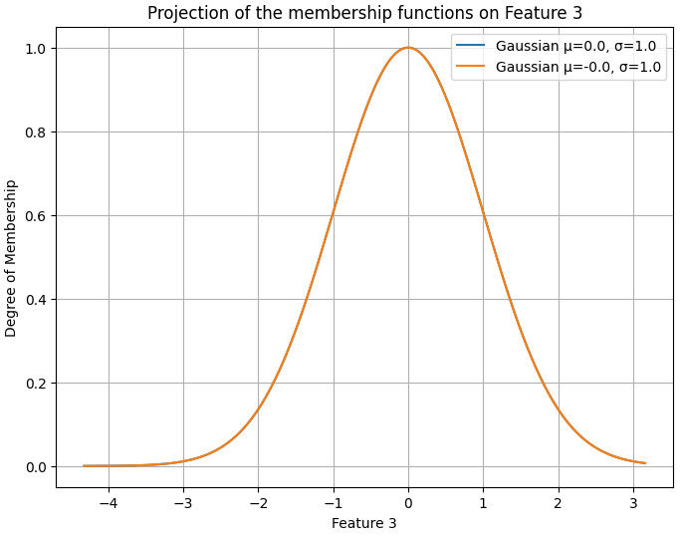
Results interpretation
Figure 6 – Clustering results (plotted on two features)
Figure 7 – Overlapping membership functions for one of the features
24

Slide 26
Conclusion

Slide 27
Conclusion
Application of TSK model with accuracy of 65%;
Struggle to capture the underlying patterns in the data, showed by incorrect predictions made with high confidence;
Limited ability to generalise, due to small sample size and low variance.
26

